Slide 1

DESIGN WORKSHOP
LESSON 8
CFGDEGREE → FULL-STACK STREAM

Slide 2

AGENDA
01 Introduction to Affordance
02 What is wireframing?
03 Wireframing exercise
04 Project work

Slide 3


What is Affordance?
And who called it affordance of all things?
All items tend to have hints on how they can be used - for example, scissors have only very few ways that they can be gripped, or door knobs can only be handled in certain ways, giving you hints on how to use it.
These hints are called affordances - for example, a steering wheel’s hint is how it can be twisted - no one pushes or pulls at one automatically because of the implicit hint we receive from it!
This is what distinguishes good doors from bad - if you pushed instead of pulled, it’s probably the doors fault! It told you the wrong information (e.g. push)

Slide 4
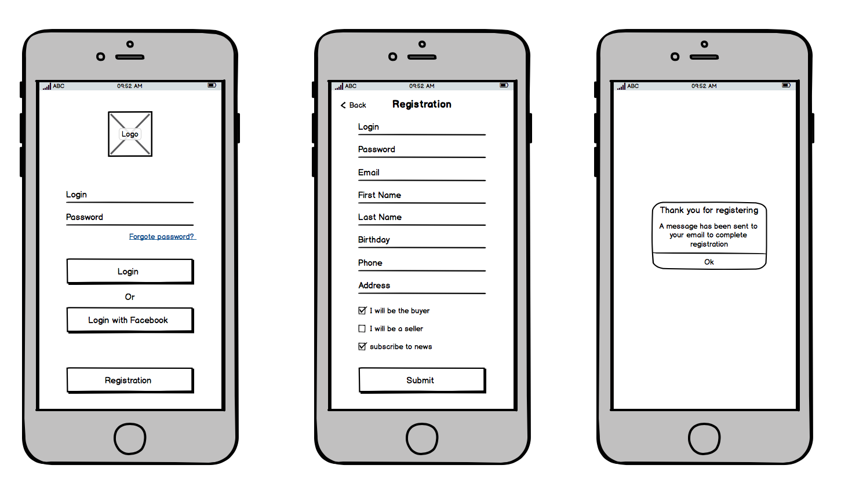
What is wireframing?
And what’s the point of it?
# WIREFRAMING EXAMPLE (FOR A MOBILE APP)
Wireframing is a process where we create the base structure of a prototype - there is no code or fancy behaviour, it’s simply a architectural design diagram.
Through wireframing, we can practice the heuristics and principles learnt on a easy platform - it’s a sketching environment where we can create the prototype before committing to it in sheer code.
Recommended tool for something like this is Draw.io!

Slide 5

Exercise 1: Wireframe a prototype!
Wireframe a prototype design for the requirements below
I have a collection of books, and would like people to be able to borrow them.
People should be able to borrow them after creating an appointment that lists the time, date and location to pick the book up from
People should be able to choose which book to borrow from the collection
The collection, and the ability to borrow, should be available on a website
Given these requirements, sketch a prototype that meets these requirements for the client
You have approx. 35 minutes for this (depending on your instructor's discretion + current time!). Google when you can!
Split into groups and create a wireframe (e.g. via draw.io) - at the end, present your design, explaining what design choices you made (e.g. positioning, colours, function, etc) and why!

Slide 6

Exercise 1: Present your wireframe solution!
Showcase the prototype!
On a team-by-team basis, present your solution!
Others: Share your feedback! What was usable about it? What was confusing? etc

Slide 7
Project: Continue working on your project!
And make sure you wireframe before you start any code!
For the rest of the session, please break into your group project teams and work on your group project!
Please create a wireframe for your group project - this is critical and incredibly helpful for any project development. Make use of what we’ve learnt with design recently too!
Once the wireframe is completed, feel free to continue with the rest of the project / code your design up!
You have approx. however long is left in the session for this!

Slide 8
SUMMARY
Wireframing is a mechanism to design your prototype up before actually coding it - it allows us to see what it’ll look like beforehand (making it easy to get client feedback, make modifications ourselves, etc)
All items have hints - these hints on they can be used are referred to as affordances
Everything should ideally be designed - it allows us to maximise its usability + wireframing it in advance lets us design it most effectively (as we do it from the start instead of mid-code).

Slide 9
THANK YOU!

